Slide 1
Virtual Symptom Checker & FAQ Assistant
AIS421:NLP Applications
Presented to:
Dr. Ensaf Hussein Mohamed
Eng.Ziad Mohamed Elshaer
Farah Fawki 211001836
Uomna Hesham 211001623
Nada Atef 211001921
Mai elgazzar 211001757
Passant Saad 19200072

Slide 2
Table of contents
01
02
03
04
05
06
Introduction
Problem/Gap
Methods and implementation
Dataset
Results and Discussion
Conclusion

Slide 3
Introduction
This paper suggests a multi-agent medical chatbot system for improving response accuracy with the help of task-oriented agents. Two models of a medical chatbot are compared: one utilizes Retriever, Summarizer, and Generator agents, while the other uses a Symptom Checker and Treatment Suggestion agent in place of the latter two. The study explores how role-specialized agents can render chatbot responses more relevant and clinically useful in a healthcare setting.

Slide 4
Problem/Gap
Despite AI advancements, existing medical chatbots often:
Lack modular intelligence—no task-specific agent roles
Deliver low clinical precision in diagnosing and suggesting treatments
Rely on single-model pipelines, limiting contextual understanding
Rarely use multi-agent architectures, despite their proven benefits in healthcare AI
Key Challenge:
Chatbots fail to replicate the collaborative, specialized nature of real-world medical decision-making.

Slide 5
Dataset
Dataset: Medical Chatbot Dataset (Public)
Total Records: ~47,000 Q&A interactions
Selected Subset: 3,000 rows for efficiency and manageability
Fields:
short_question: Natural language medical query
short_answer: Informative medical response
tags: Keywords (e.g., symptoms, conditions)
label: 1 or -1 (correctness of answer)
Split: Training and validation sets used for experiments

Slide 6
Methods and Implementation
A. Data preprocessing
B. Language Model and Framework
Preprocessing Steps:
Convert to lowercase
Remove stop-words
Normalize text
Remove special characters, HTML tags, and links
Merged short_question and short_answer into one structured text per record
Created a unified knowledge base for improved retrieval
Enhanced context for better model understanding and response generation
LLM Used: Gemini-2.0-Flash by Google
Framework: LangChain
RAG Architecture: Retrieval-Augmented Generation
Knowledge Base: Built from preprocessed dataset
Vector Store: Chroma + HuggingFaceEmbeddings
Retriever: Top-k = 3 documents per query using semantic search

Slide 7
Methods and Implementation
C. Agents Design
D. Prompt Engineering & Parsing
Model 1: Retriever → Summarizer → Generator
Retrieves, summarizes, then generates the final answer
Model 2: Retriever → Symptom Checker → Treatment Suggestion
Checks symptoms and suggests treatments using retrieved context
All Agents: Executed via LangChain AgentExecutor
Prompted with: Zero-shot prompting
Memory: Stored conversation history for context
Prompt Templates:
prompt_retrieve: Fetch related documents
prompt_summarize: Create accurate summaries
prompt_answer: Generate the final response
Custom Parser: MedicalOutputParser
Agent Communication: Managed using LangChain’s ReAct framework

Slide 8
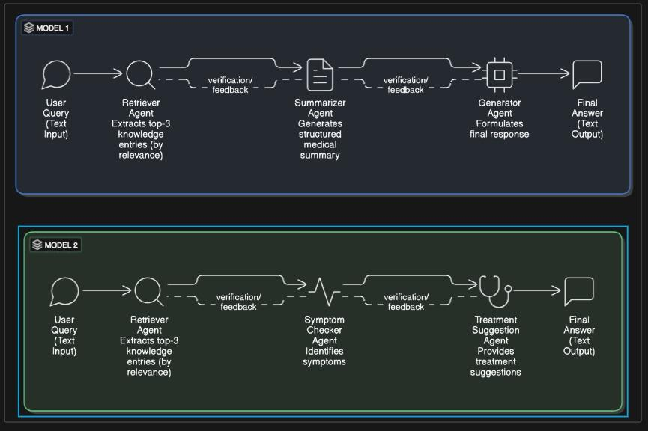
pipeline

Slide 9
Results
BERT Score
Validation
Quantified Model Superiority: BERT Score Analysis Reveals Model 2's F1 Score Improvement from 0.7881 to 0.8138 (+3.3%) with Enhanced Recall Performance (0.8560 vs 0.7926)
Cross-Validation Consistency: Multi-Round Evaluation Demonstrates System Stability Across Variable Sample Sizes (10, 20, and 50 Question-Answer Pairs) with Reliable Performance Metrics
Precision and Recall
Model 2 showed enhanced recall performance (0.8560) compared to Model 1 (0.7926), with precision scores of 0.7755 for Model 2 versus 0.7843-0.7948 for Model 1

Slide 10
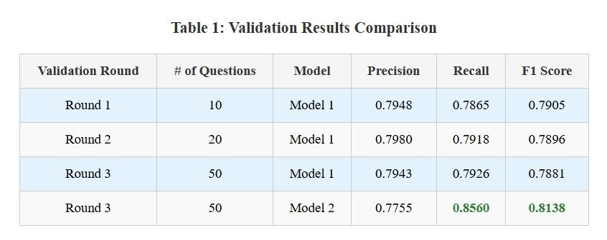
Results

Slide 11
Conclusion
We proposed a multi-agent, modular medical chatbot system that improves the correctness and relevance of automated health responses. We compared two systems and found that a model with a Symptom Checker and Treatment Suggestion agent was better rated based on F1 score (0.8138) due to improved recall. This identifies the significance of task-specific functions of agents. Our study shows the growing impact of multi-agent AI on medicine. Real-time applicability of data, multimodal input and reinforcement learning are promising future directions to make AI healthcare devices patient-centric and more dynamic.

Slide 12
Thank you!

Slide 13
References
S. Ahmad et al., “Conversational Skills of LLM-based Healthcare Chatbot for Personalized Communications,” in Proc. 2024 Int. Conf. Information Technology for Social Good (GoodIT), 2024, pp. 1–6.
R. Verma et al., “MEDIBOT—An AI Powered Chatbot,” in Proc. 2024 16th Int. Conf. Contemporary Computing (ICCAI), 2024, pp. 120–125.
M. M. Rahman and S. A. Mahmood, “A Multi-Agent Prototype System for Medical Diagnosis,” in Proc. IEEE Conf. Publications, 2008, pp. 451–456.
J. Smith et al., “Powering an AI Chatbot with Expert Sourcing to Support Credible Health Information Access,” in Proc. 28th Int. Conf. Intelligent User Interfaces (IUI), 2023, pp. 304–313.
A. Chen et al., “Coordination and Learning in Multi-Agent Systems for Healthcare Applications,” in Proc. 23rd Int. Conf. Autonomous Agents and Multi-Agent Systems (AAMAS), Auckland, New Zealand, 2024, pp. 678–687.
L. Tan et al., “Predictive Maintenance in Healthcare Using Prognostics Models,” in Proc. IEEE Conf. Prognostics and Health Management, Spokane, WA, USA, Jun. 17–19, 2024, pp. 98–104.
H. Zhang et al., “AI-Driven Diagnosis Support in Medicine,” in Proc. 2024 5th Int. Symp. Artificial Intelligence for Medicine Science (ISAIMS), 2024, pp. 210–216.
Z. Ni et al., “Implementation of Chatbot Technology in Health Care: Protocol for a Bibliometric Analysis,” JMIR Research Protocols, vol. 13, art. no. e54349, 2024.
K. Patel et al., “Machine Learning Models for Healthcare Conversations,” in Proc. Machine Learning for Healthcare Conf. (ML4HC), 2025, pp. 135–144.

